Slide 1
Business Memo and Notice

Slide 2
What is a Business Memo?
A Business Memo is designed to accommodate busy readers.
It is a short document used to transmit information within an organization.
Business memos are brief, direct, and easy to navigate.

Slide 3
Types of Memos in IT Organisations
Project Updates
Meeting Announcements
Policy Changes

Slide 4
Uses of a Business Memo
Readers make policy and action decisions based on the recommendations.
Readers obtain specific information (evidence) needed to
understand and
justify policy and action decisions.

Slide 5
How to Write a Business Memo?
Provide the main point first, so that readers can quickly grasp the content and significance of the memo.
Provide supporting details, so if readers want more information, they can continue reading.
Your style should be professional, straightforward, and easy to read.
To achieve such a style, use short, active sentences.

Slide 6
Writing a Business Memo
Business memos usually begin with a header section that lists recipients and other details in the following format:
To: Include each recipient’s name and job title (for example, Miranda Lawson, Director of Marketing).
If you are addressing a designated group, simply state the name of the group (for example, Accounting Department).
From: Include your name and title.
Date: Write out the complete date (for example, November 24, 2023).
Subject: Make the subject brief and clear.

Slide 7
(Continuation)
Most business memos skip the greeting (such as “Greetings, Ms. Lawson”) and immediately go into the body text.
Whenever you start a paragraph in a memo, always put the main point of that paragraph first, as this makes your writing direct and easy to follow.
Generally, memos do not include a farewell (such as “Sincerely, Tonya”), but it may be appropriate depending on your message or your company’s style.

Slide 8
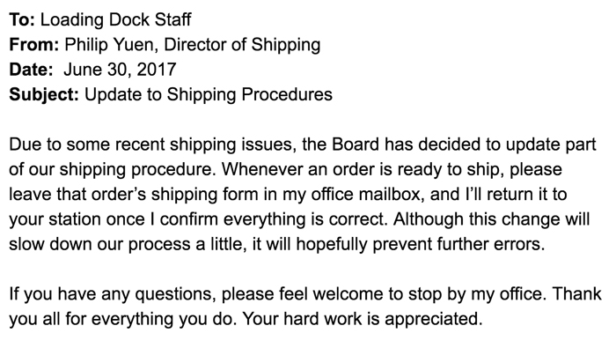
Sample Memo

Slide 9
What is a Business Notice?
Notices are meant for broader audience.
Notices inform about events or important announcements.
Notices are handy, short, and straight in conveying information.

Slide 10
Types of Business Notices
System downtime notices
Security Alerts
Announcements about Training and Workshops
Emergency Notifications
Employee Recognition

Slide 11
Tips on Notice Writing
A Well-Written Notice Must Inform the Readers About Five Questions
What is Going to Happen
Where It Will Take Place
When It Will Take Place
Who Can Apply or is Eligible For.
Whom to Contact or Apply to

Slide 12
How to write a business Notice?
Company Name or logo
Date
Notice Type
Salutation
Subject
Body (Key points)
Complementary Close
Signature

Slide 13
Format of a Notice
[Company Logo or Name]
[Date of Issuance]
[Notice Type: Announcement/Policy Change/Reminder]
Dear Team,
Subject: Implementation of New Work from Home Policy
This is to inform all employees that, starting from [Effective Date], the company will be implementing a new Work from Home Policy to enhance flexibility and productivity.

Slide 14
(Continuation)
Key Points of the Policy:
- Eligibility criteria for remote work.
- Guidelines for requesting work-from-home days.
- Expectations regarding communication and work deliverables.
- Security protocols for remote access to company resources.

Slide 15
(Continuation)
All employees are required to review the attached detailed policy document by [Deadline Date]. Compliance with this policy is mandatory for all eligible employees.
For any queries or clarifications regarding this new policy, please reach out to [Contact Person/Department] at [Contact Information].
Thank you for your attention to this matter.
Sincerely,
[Issuing Authority's Name]

